Slide 1


Wine Quality
BUAN 6356.501
Group 3
Trang Nguyen
Shimaoling Kuang
Zhuoran Qiu
Sahil Hira
Tanvi Agarwal
Venkata Naga Satya Sangeeta Eluri

Slide 2

True Story

Slide 3


Process Introduction
Understanding
Cleaning & Preparing
Model Selecting
Testing & Evaluation
Future Enhancement

Slide 4
Understanding the data
Classification data:
White wine – 4898 vs Red wine – 1599
11 variables
No missing value
Potential Factors:
Fixed acidity
Volatile acidity
Density
PH
Chlorides
Free sulfur dioxide
Alcohol
Output variable (based on sensory data):
quality (score between 0 and 10)

Slide 5



Cleaning and Preparing
Transform text data (separated by “;”)
Transform data type from numerical to categorical with 2 intervals
Good quality: White: (6, 9] ; Red: (6, 8]
Not Good quality: White: (3, 6] ; Red: (3, 6]
Split the data: 75/25
Use SMOTE for class imbalance problem
（Training Data）
Web link: http://archive.ics.uci.edu/ml/

Slide 6
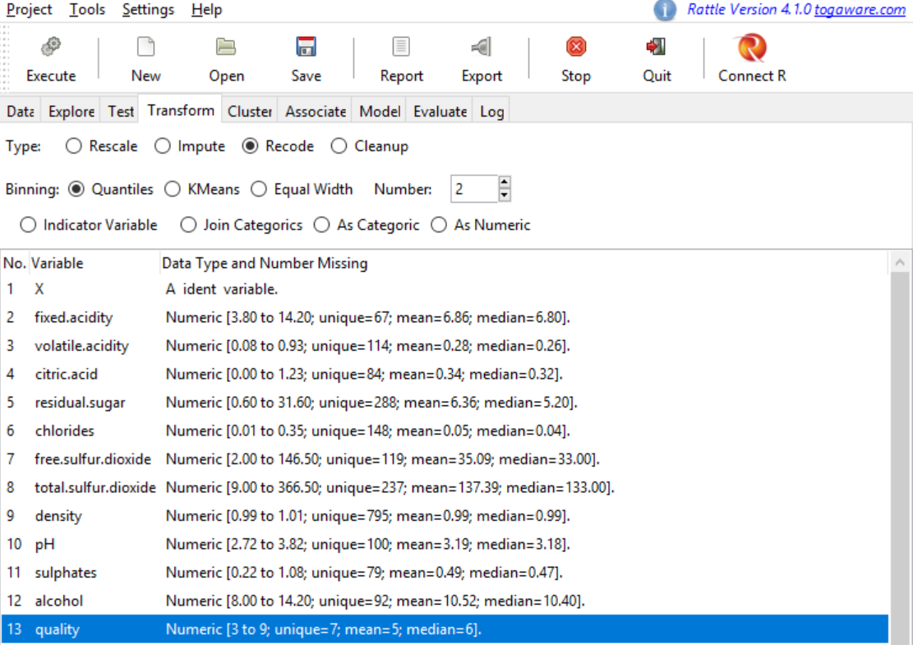
Cleaning and Preparing
Splitting quality into intervals (transform numerical -> categorical)
Notes:
White
# Split the dataset into a training and test dataset using a split of 75% training# and 25% test
set.seed(42)
nrow(data)
trainingObs_white<-sample(nrow(data),0.75*nrow(data),replace=FALSE)

Slide 7
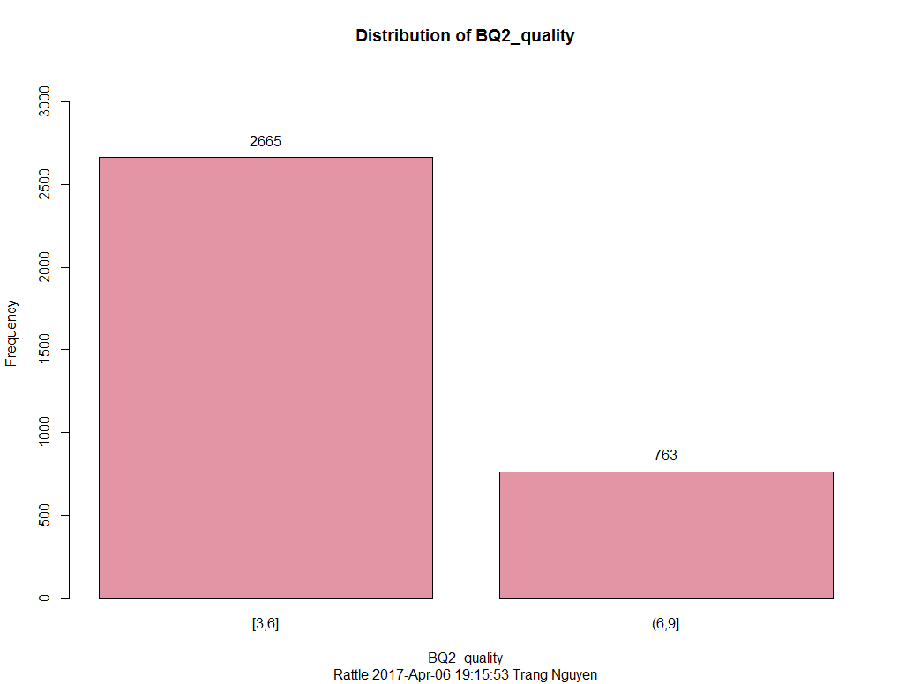
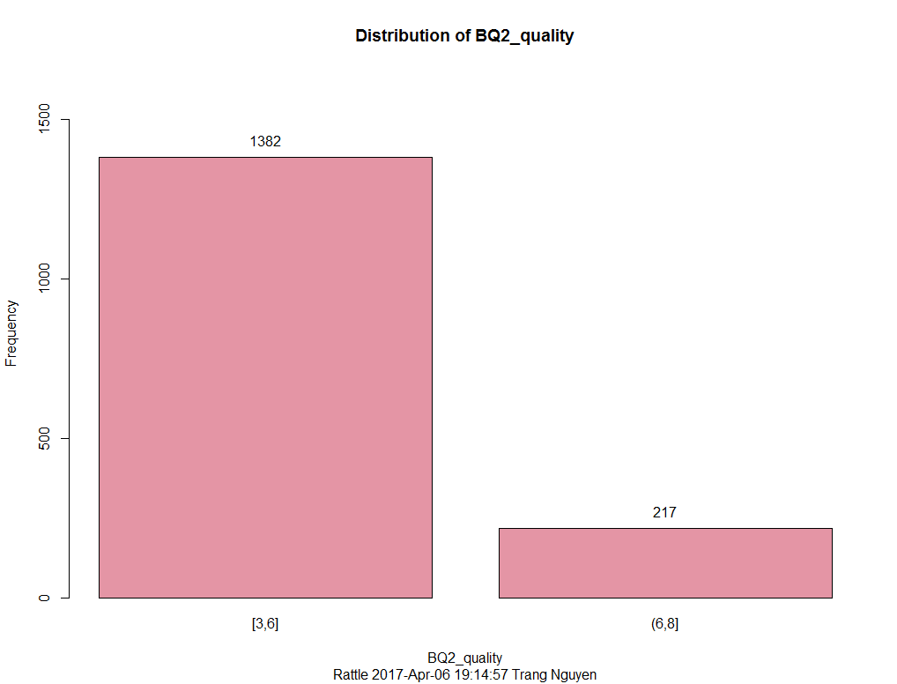
Cleaning and Preparing
Before
Red
White
White Wine Distribution
Red Wine Distribution
Not Good
Good
Not Good
Good

Slide 8
Cleaning and Preparing
Red
White
Imbalance
!!!
SMOTE
Notes:
White
#smote training data
table(trainingDS_white$BQ2_quality)
smoted_white<-SMOTE(BQ2_quality ~ ., trainingDS, perc.over=330, perc.under= 135)
table(smoted_white$BQ2_quality)
write.csv(smoted_white, file="white_train_smote.csv")
Red
# Split the dataset into a training and test dataset using a split of 75% training
# and 25% test
set.seed(42)
trainingObs_red<-sample(nrow(data1),0.75*nrow(data1),replace=FALSE)
# Create the training dataset
trainingDS_red<-data[trainingObs_red,]
View(trainingDS_red)
# Create the test dataset
testDS_red<-data[-trainingObs_red,]
View(testDS_red)
write.csv(testDS_red,file="red_test.csv")
#smote training data
table(trainingDS_red$BQ2_quality)
smoted_red<-SMOTE(BQ2_quality ~ ., trainingDS_red, perc.over=400, perc.under= 125)
table(smoted_red$BQ2_quality)
write.csv(smoted_red, file="red_train_smote.csv")

Slide 9
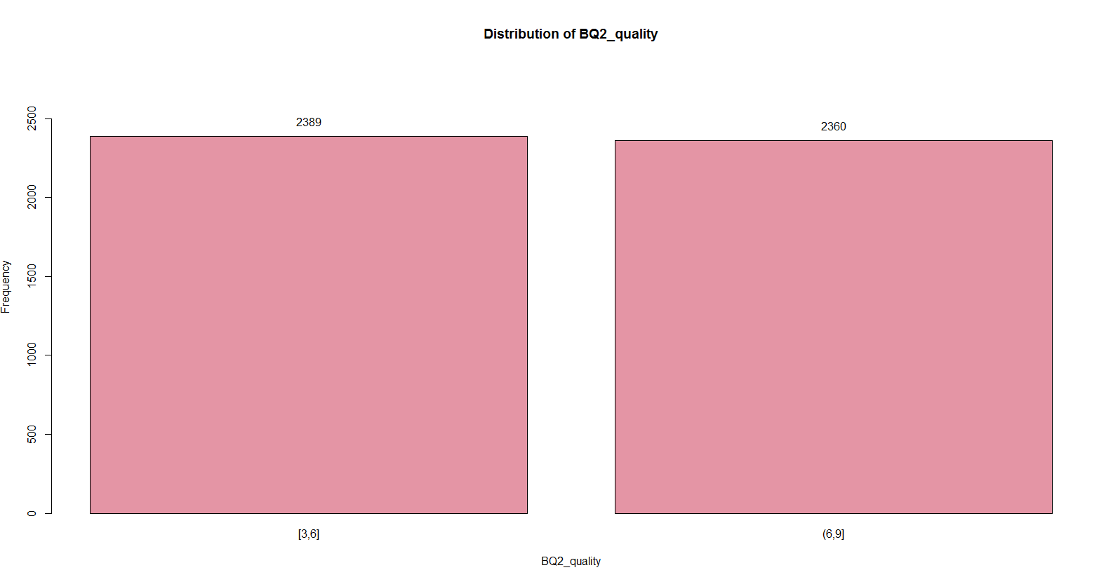
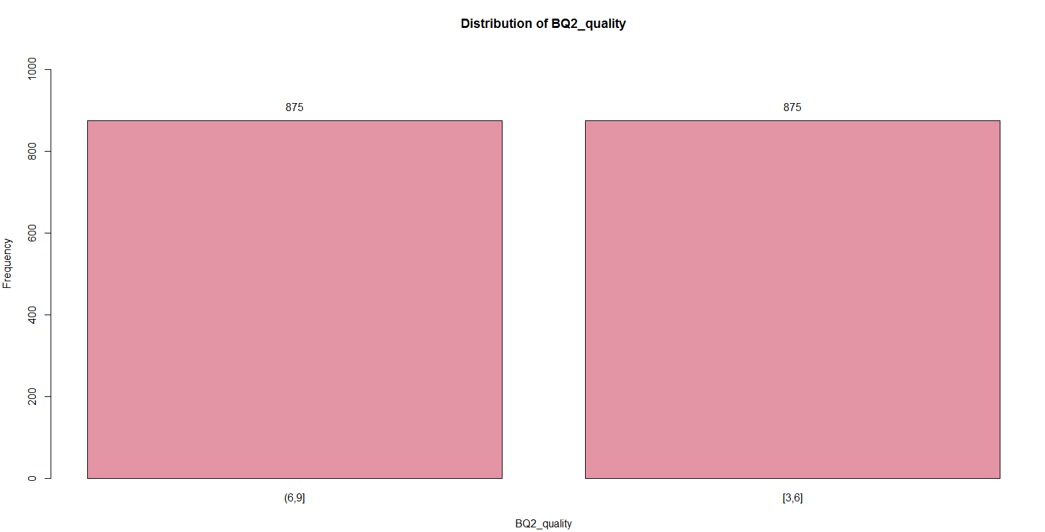
Cleaning and Preparing
After
Red
White
White Wine Training Distribution
Red Wine Training Distribution
2389
2360
875
875
Not Good
Good
Not Good
Good

Slide 10
Model Selecting
Decision Tree Model
Random Forest
ADA Boosting

Slide 11
Model Selecting Decision Tree _ White
Decision Tree Model
Hierarchical group of relationship among attribute.
Goal is to minimize the impurity measure.

Slide 12
Model Selecting Decision Tree
Important features:
Alcohol
Free sulfur dioxide
Volatile acidity
Fixed acidity

Slide 13
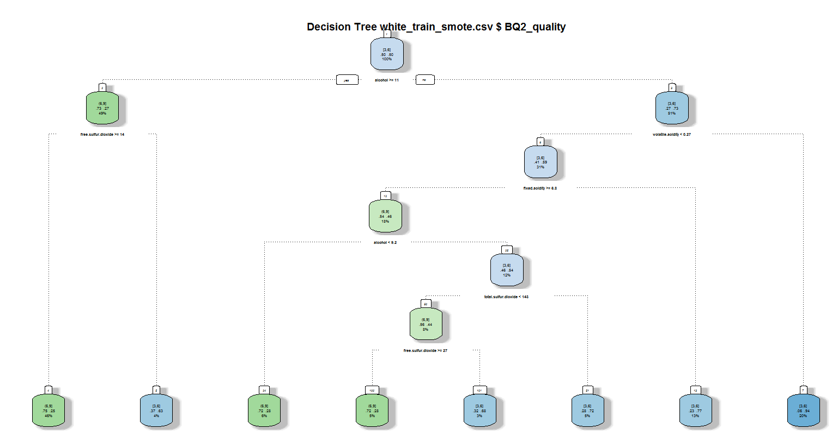
Model Selecting Decision Tree

Slide 14
Model Selecting Decision Tree
Confusion Matrix (Counts):
Overall error: 28%
Decision Tree(White) |  | Predicted
 |  | (6,9] | [3,6]
Actual | (6,9] | 139 | 34
 | [3,6] | 208 | 476
F1: 0.53
Recall: 0.80
Precision: 0.40
Accuracy: 0.72
Confusion Matrix (Proportions):
Decision Tree(White) |  | Predicted
 |  | (6,9] | [3,6]
Actual | (6,9] | 0.16 | 0.04
 | [3,6] | 0.24 | 0.56

Slide 15
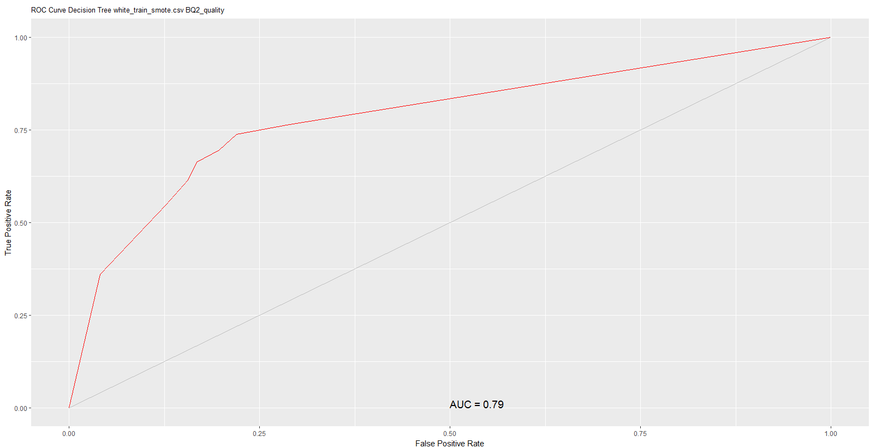
Model Selecting Decision Tree _ White

Slide 16
Model Selecting Random Forest
Random Forest
Group of decoupled trees, working on bagging technique.
Ensemble learning method - manipulate
input attributes.

Slide 17
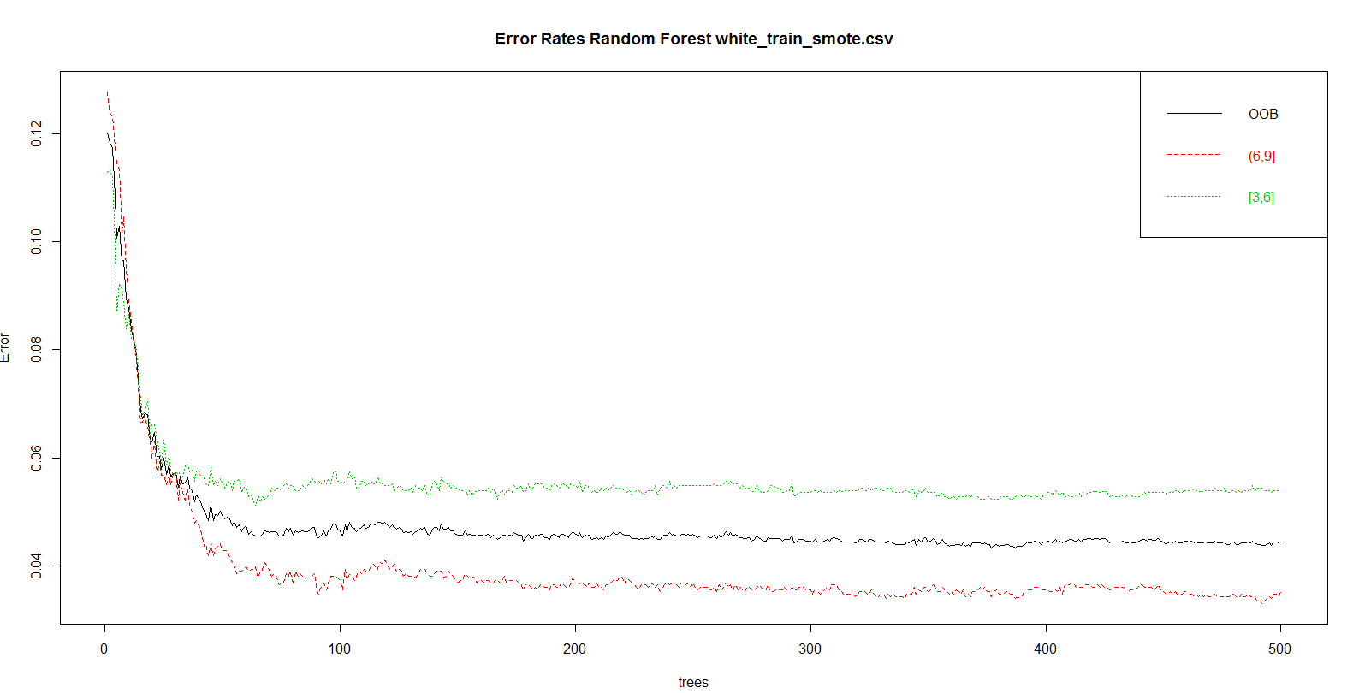
Model Selecting Random Forest

Slide 18
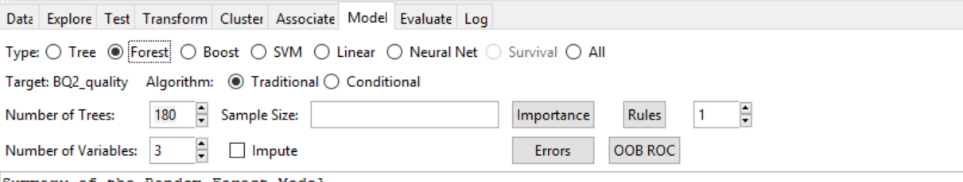
Model Selecting Random Forest

Slide 19
Model Selecting Random Forest
Confusion Matrix (Counts):
Overall error: 16%
Random Forest(White) |  | Predicted
 |  | (6,9] | [3,6]
Actual | (6,9] | 140 | 33
 | [3,6] | 102 | 582
F1: 0.68
Recall: 0.81
Precision: 0.58
Accuracy: 0.84
Confusion Matrix (Proportions):
Random Forest(White) |  | Predicted
 |  | (6,9] | [3,6]
Actual | (6,9] | 0.16 | 0.04
 | [3,6] | 0.12 | 0.68

Slide 20
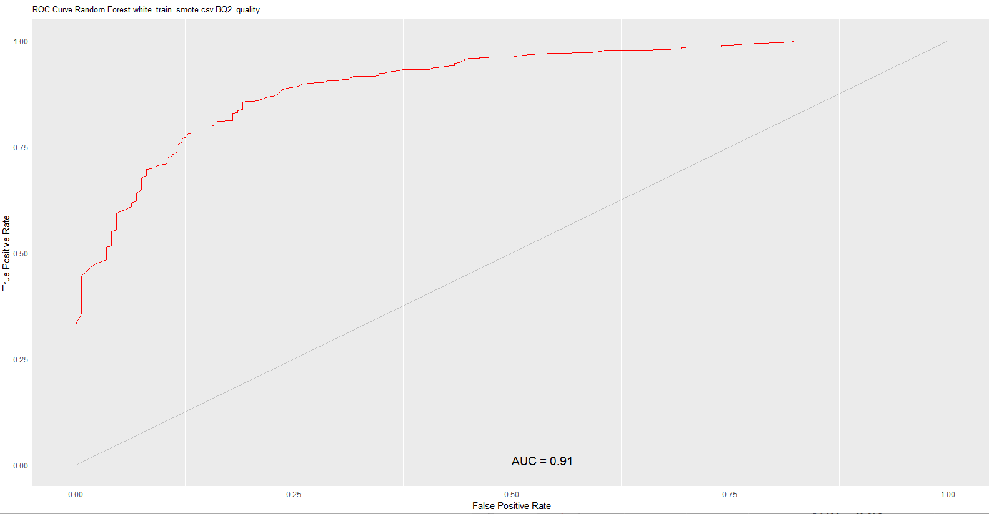
Model Selecting Random Forest

Slide 21
Model Selecting ADA Boosting
ADA Boosting
Iterative technique - change distribution of training data.
weight assigned to each observation.
Final result is the aggregation of base classifiers obtained at each round/iteration.

Slide 22
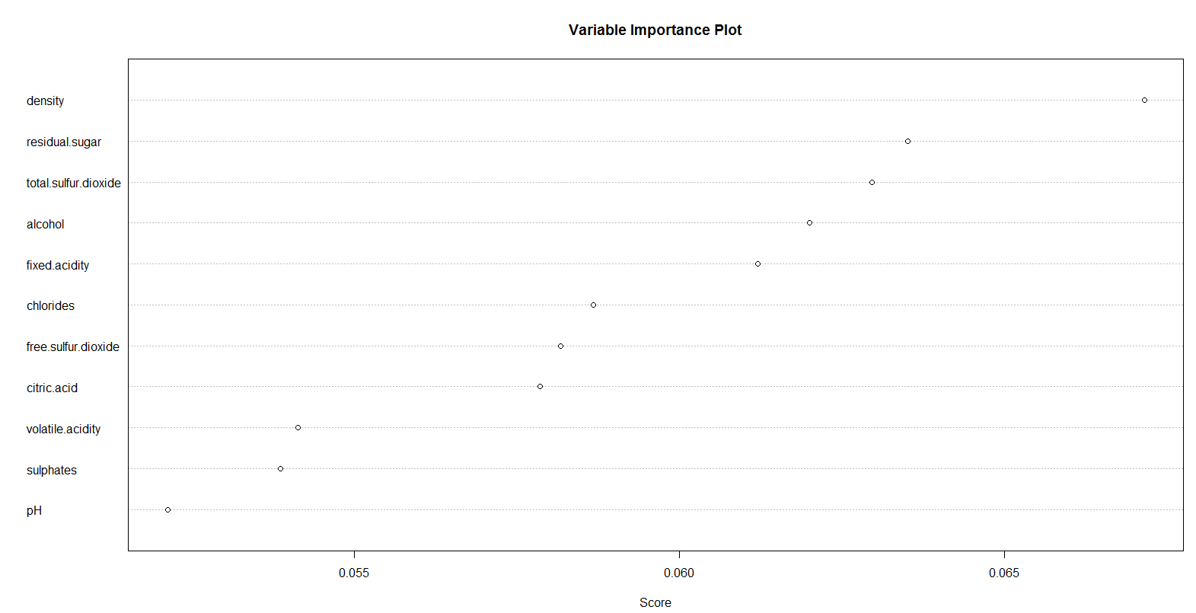
Model Selecting ADA Boosting
Important features:

Slide 23
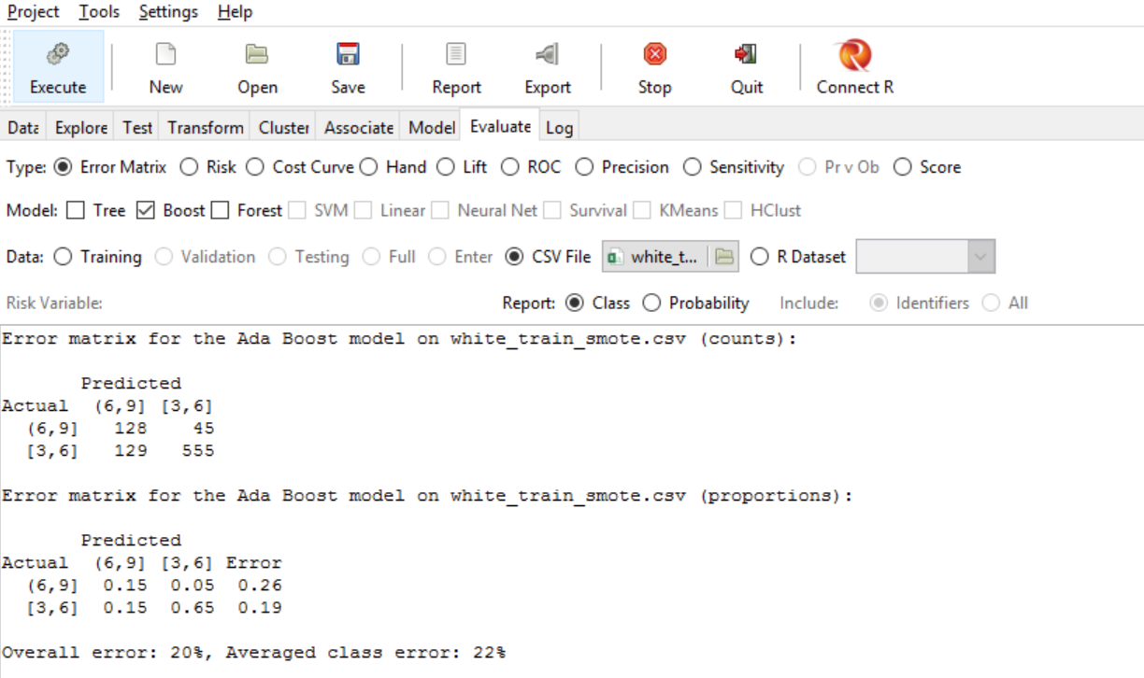
Model Selecting ADA Boosting

Slide 24
Model Selecting ADA Boosting
Confusion Matrix (Counts):
Overall error: 20%
ADA Boosting(White) |  | Predicted
 |  | (6,9] | [3,6]
Actual | (6,9] | 128 | 45
 | [3,6] | 129 | 555
F1: 0.60
Recall: 0.74
Precision: 0.50
Accuracy: 0.80
Confusion Matrix (Proportions):
ADA Boosting(White) |  | Predicted
 |  | (6,9] | [3,6]
Actual | (6,9] | 0.15 | 0.05
 | [3,6] | 0.15 | 0.65

Slide 25
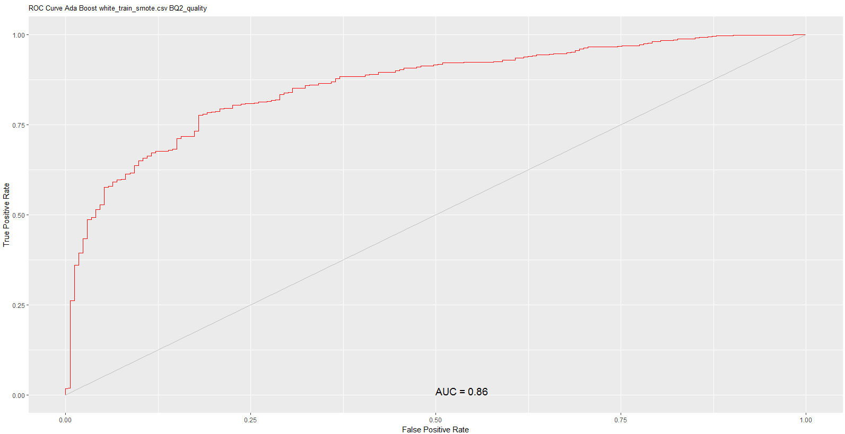
Model Selecting ADA Boosting

Slide 26
Model Selecting Decision Tree _ Red
Important features:
Alcohol
Free sulfur dioxide
Volatile acidity
Fixed acidity

Slide 27
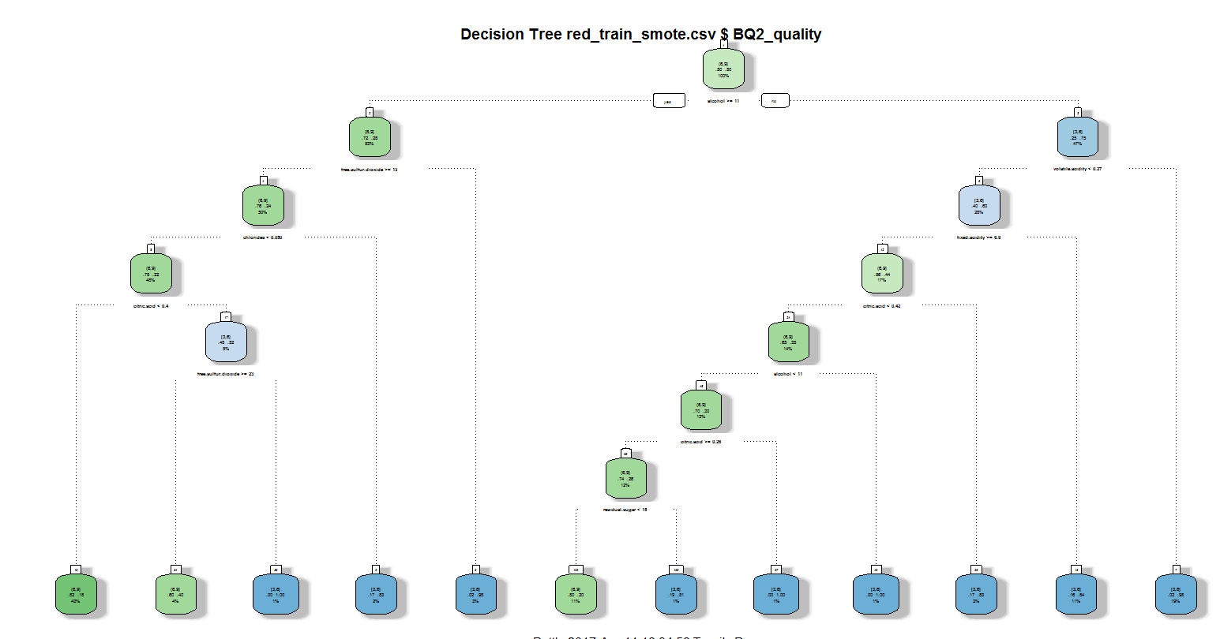
Model Selecting Decision Tree _ Red

Slide 28
Model Selecting Decision Tree
Confusion Matrix (Counts):
Overall error: 30%
Decision Tree(White) |  | Predicted
 |  | (6,9] | [3,6]
Actual | (6,9] | 419 | 169
 | [3,6] | 602 | 1399
F1: 0.52
Recall: 0.71
Precision: 0.41
Accuracy: 0.70
Confusion Matrix (Proportions):
Decision Tree(White) |  | Predicted
 |  | (6,9] | [3,6]
Actual | (6,9] | 0.16 | 0.07
 | [3,6] | 0.23 | 0.54

Slide 29
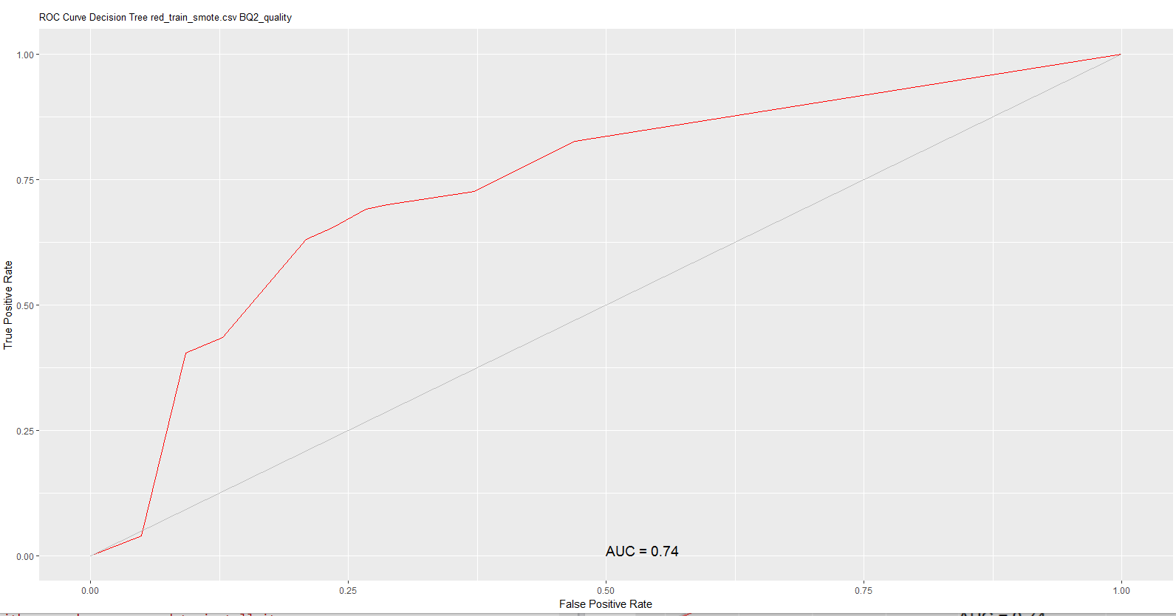
Model Selecting Decision Tree

Slide 30
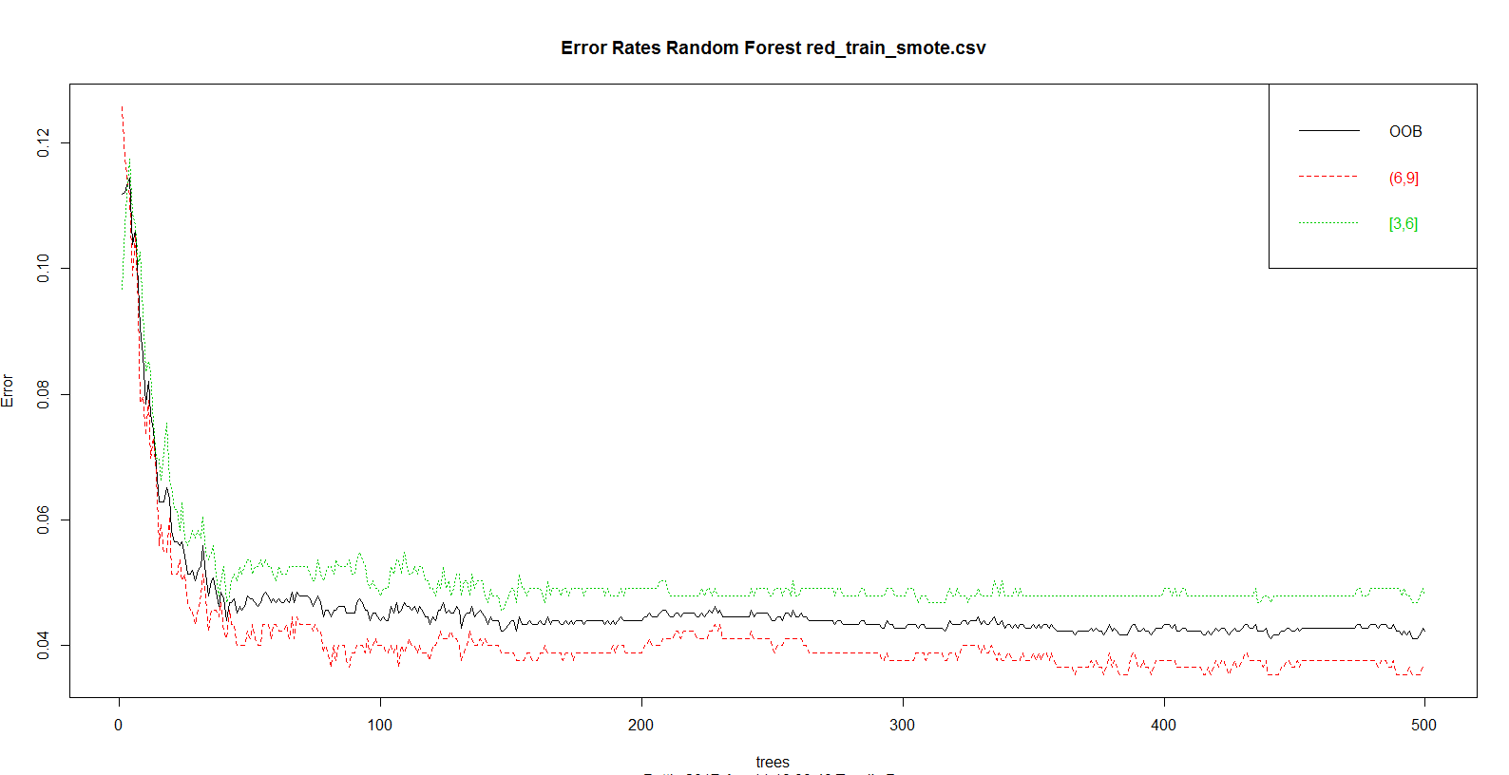
Model Selecting Random Forest

Slide 31
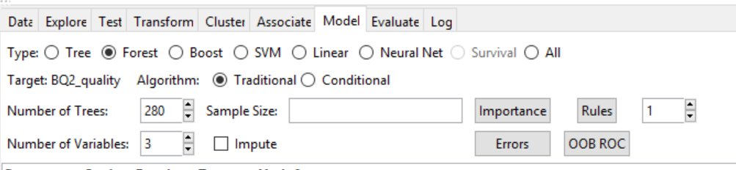
Model Selecting Random Forest

Slide 32
Model Selecting Random Forest
Confusion Matrix (Counts):
Overall error: 21%
Random Forest(White) |  | Predicted
 |  | (6,9] | [3,6]
Actual | (6,9] | 334 | 254
 | [3,6] | 292 | 1709
F1: 0.55
Recall: 0.57
Precision: 0.53
Accuracy: 0.79
Confusion Matrix (Proportions):
Random Forest(White) |  | Predicted
 |  | (6,9] | [3,6]
Actual | (6,9] | 0.13 | 0.10
 | [3,6] | 0.11 | 0.66

Slide 33
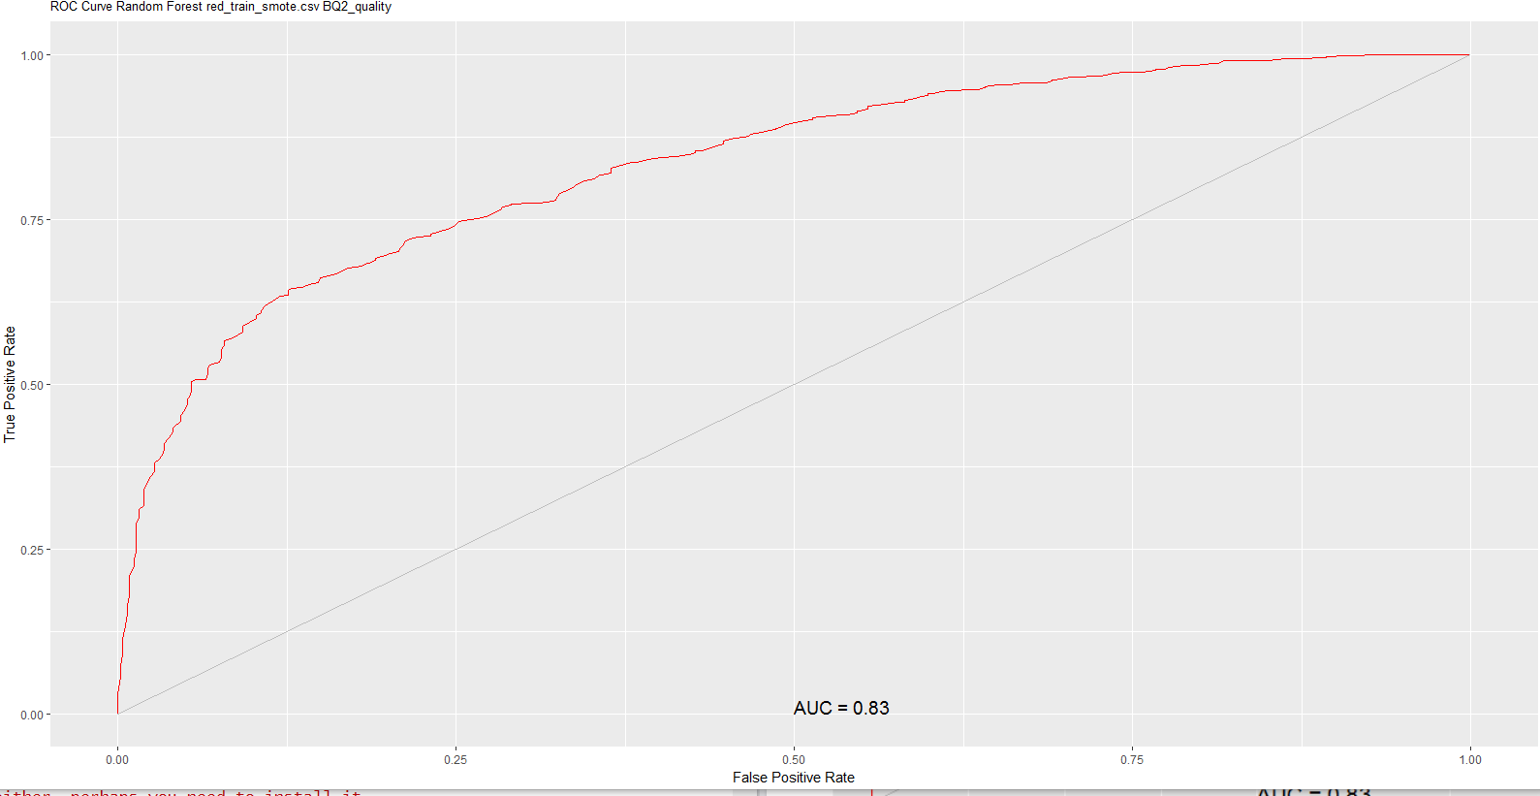
Model Selecting Random Forest

Slide 34
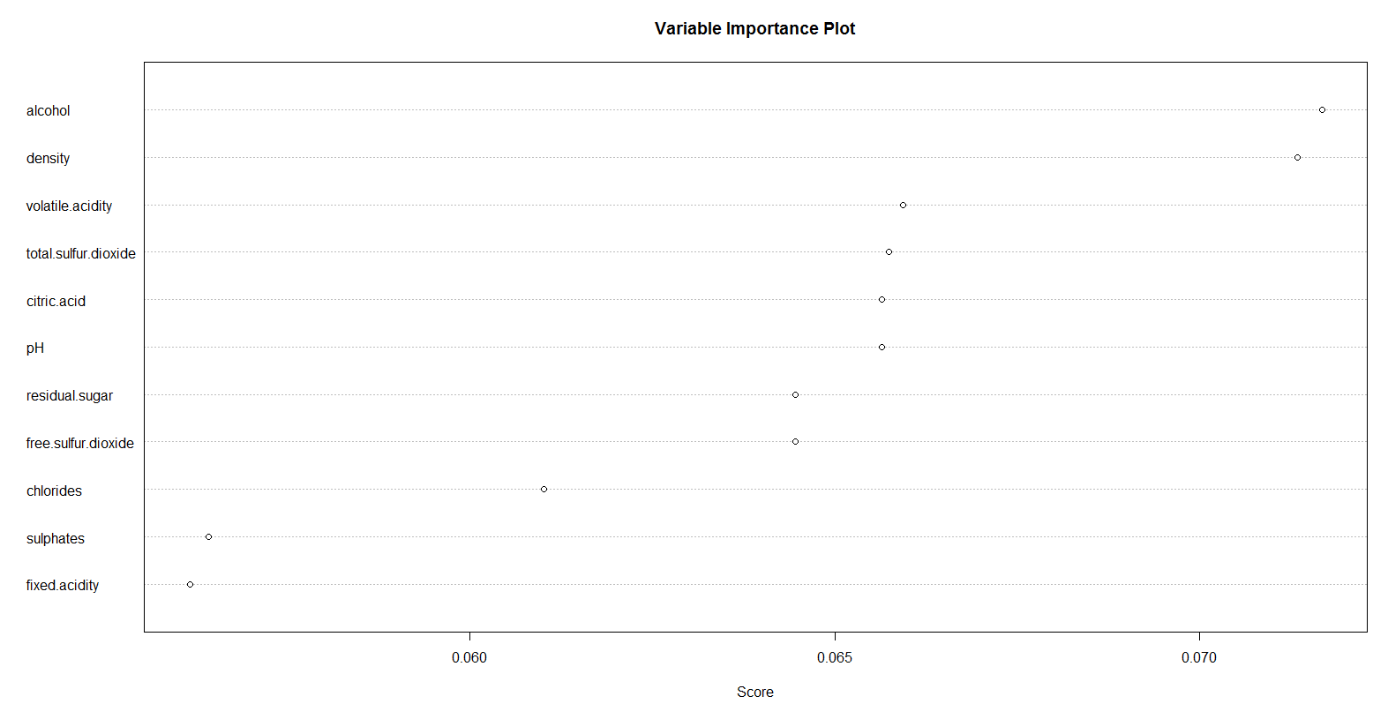
Model Selecting ADA Boosting
Important features:

Slide 35
Model Selecting ADA Boosting
Confusion Matrix (Counts):
Overall error: 22%
ADA Boosting(White) |  | Predicted
 |  | (6,9] | [3,6]
Actual | (6,9] | 327 | 261
 | [3,6] | 321 | 1680
F1: 0.53
Recall: 0.56
Precision: 0.50
Accuracy: 0.78
Confusion Matrix (Proportions):
ADA Boosting(White) |  | Predicted
 |  | (6,9] | [3,6]
Actual | (6,9] | 0.13 | 0.44
 | [3,6] | 0.12 | 0.65

Slide 36
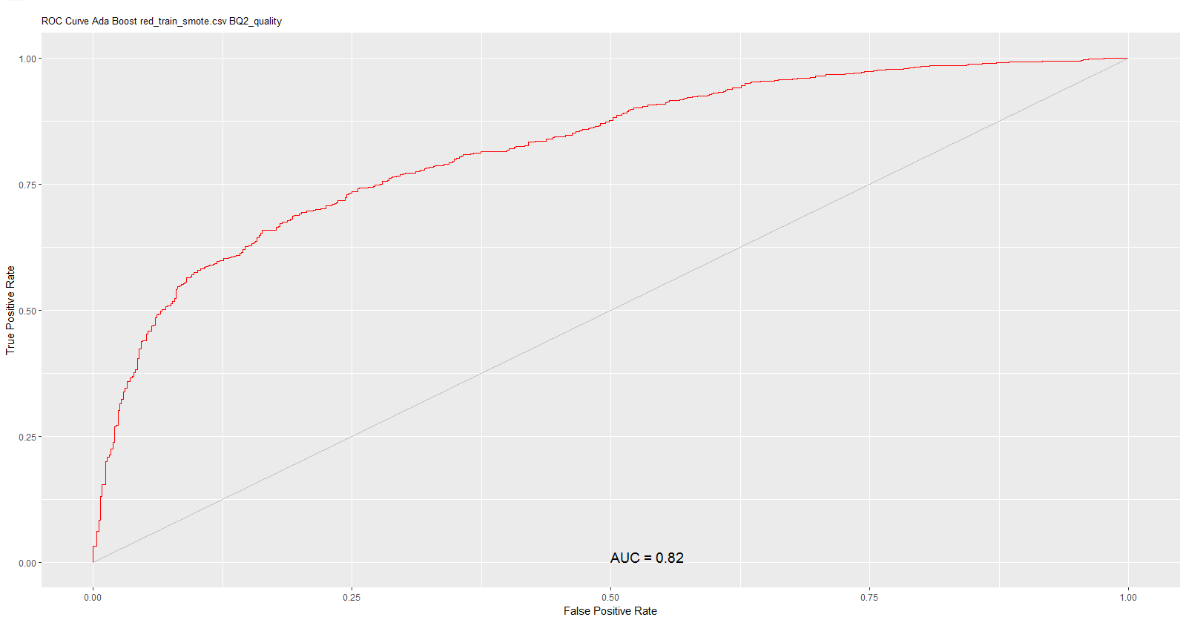
Model Selecting ADA Boosting

Slide 37
Testing and Evaluation
Random Forest performed better compared to the other models.
AUC for White Wine under RF: 0.91
AUC for Red Wine under RF: 0.83

Slide 38

Testing and Evaluation Red vs White
Important features:
Alcohol
Sulfur dioxide
Volatile acidity
Fixed acidity
The sweetness feature in White wine quality valuation is more important than in Red wine.

Slide 39
Future Enhancement
Resource management (80% of resources spent on cleaning and preparing the data set).
Understanding the data will aid in model building process.
Explore new tools (Project utilized both Rstudio and Rattle).

Slide 40


Slide 41
Reference
P. Cortez, A. Cerdeira, F. Almeida, T. Matos and J. Reis.
Modeling wine preferences by data mining from physicochemical properties.
In Decision Support Systems, Elsevier, 47(4):547-553. ISSN: 0167-9236.

Slide 42

Cheers!

